Slide 1
Meta-learning for Wireless Communication optimization
Chenghong Ren
24/06/2024

Slide 2
Agenda
Introduction
Implementation
Testing
Results
Conclusion

Slide 3
Introduction

Slide 4
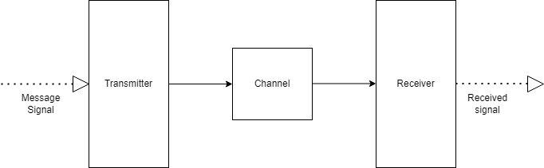
Introduction
Wireless communication

Slide 5
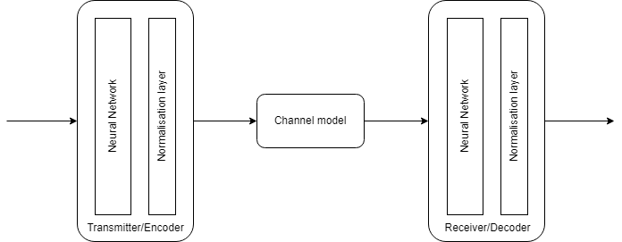
Introduction
Auto-encoder in wireless communication

Slide 6
Introduction
Problems with ML in communication
Training take a long time and large amount of data
Channel conditions changes frequently

Slide 7
Multi-task Learning

Slide 8
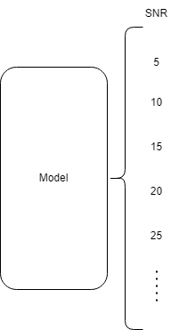
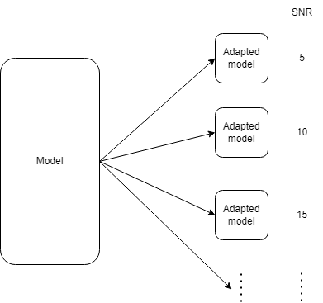
Introduction
Multi-task Learning
Joint-training
Meta-learning

Slide 9
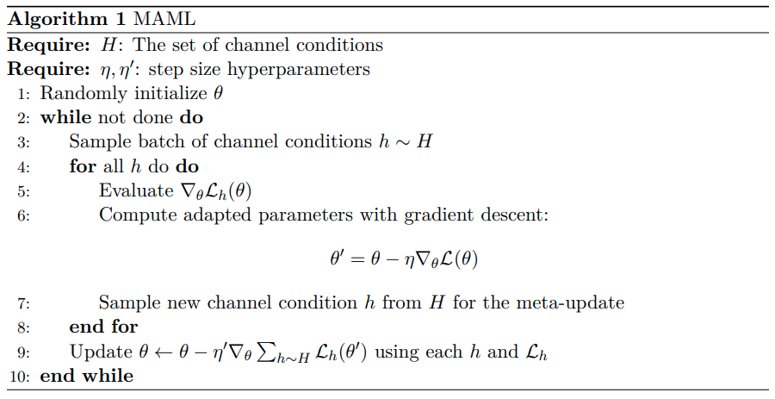
Implementation
Meta-learning algorithm

Slide 10
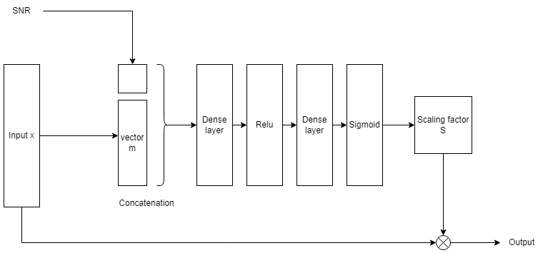
Implementation
Attention module

Slide 11
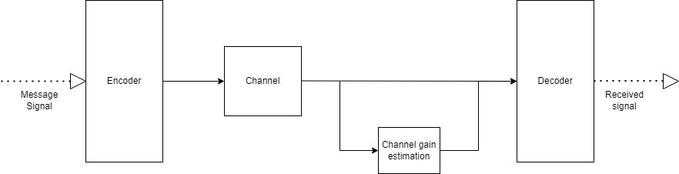
Implementation
Channel condition input

Slide 12
Methods

Slide 13
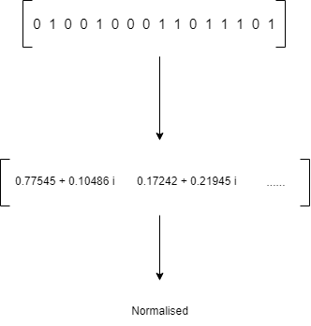
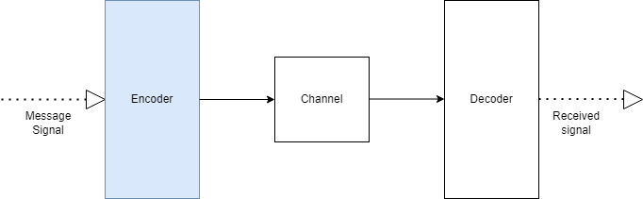

Methods
Test setup
Message vector length k = 16 bits
Complex symbols length x = 4
Power constraint ${‖x‖}^{2}=1$

Slide 14
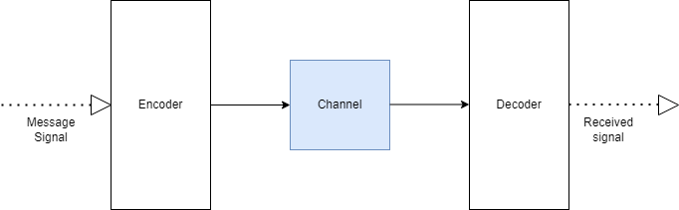
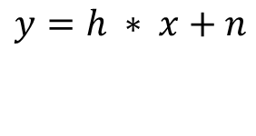

Methods
Test setup
Rayleigh fading channel
Number of channel taps = 3
Signal to noise ratio = 15dB
Complex Gaussian noise $n∼𝒞𝒩(0,SNR)$
$$y=h ∗ x+n$$

Slide 15
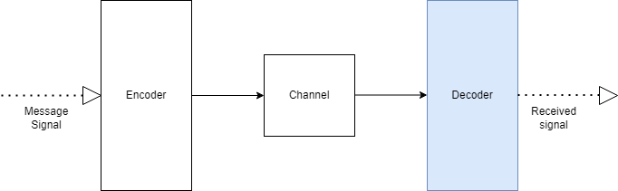

Methods
Test setup
Decoder produces a probability vector $\hat{x}$
Used to generate message bits
Evaluated using BER (block error rate)

Slide 16
Results

Slide 17
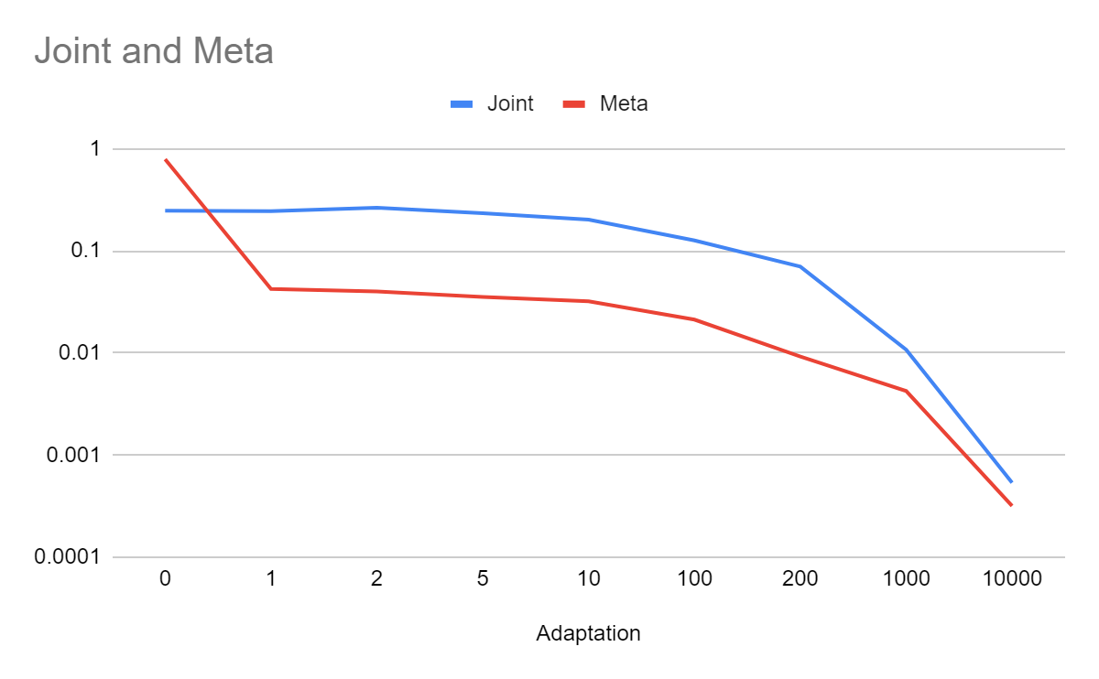
Results

Slide 18
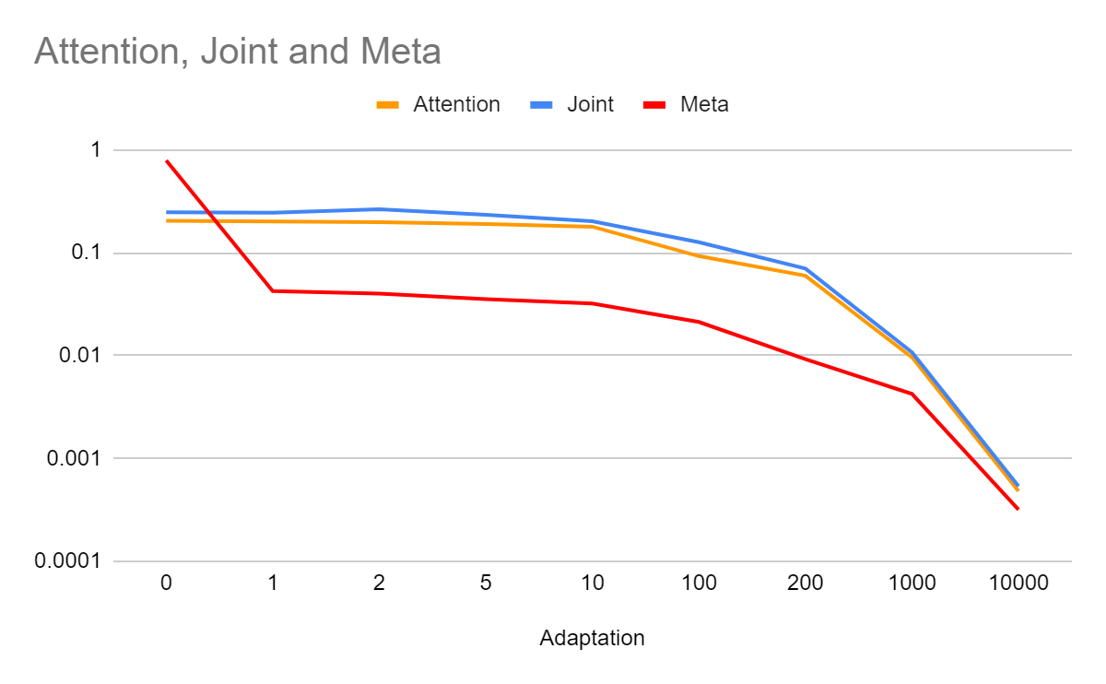
Results

Slide 19
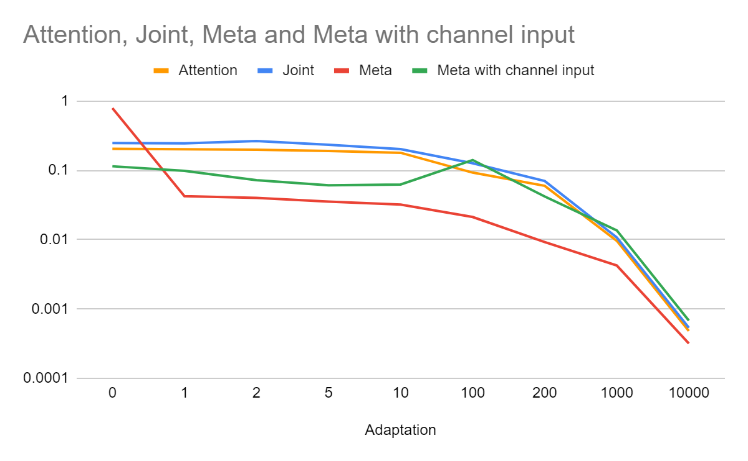
Results

Slide 20
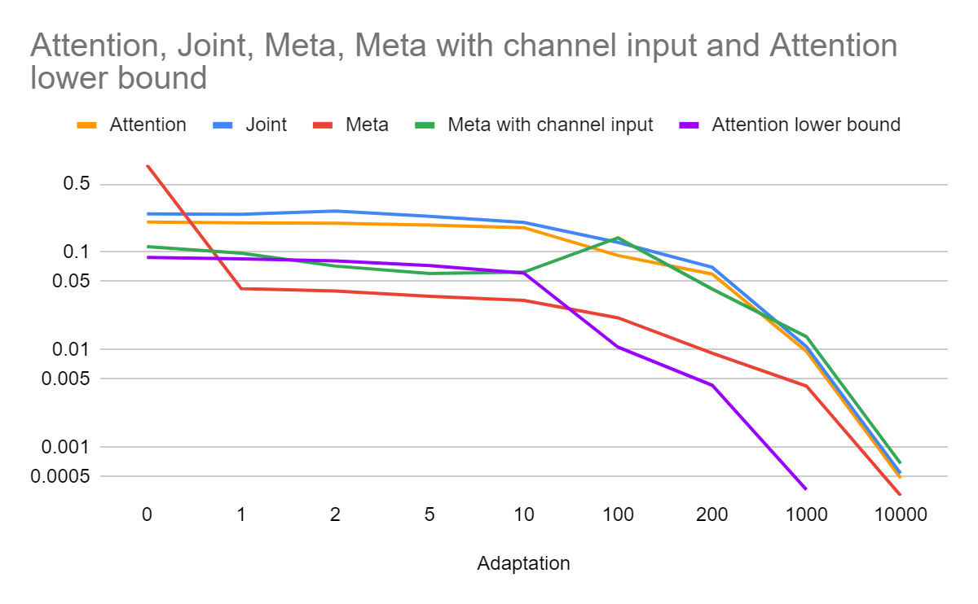
Results

Slide 21
Conclusion
Joint-training with attention module has better
performance at no adaptation.
Meta-learning quickly outperforms joint-training
at 1 or more adaptation steps.
Meta-learning maybe not be suitable for all
channel conditions.
Performance can be improved with better
channel and snr estimation techniques.

Slide 22
Conclusion
Future works:
Explore improvements on training time. E.g. federated meta-learning
Explore better more accurate Channel estimation techniques

Slide 23
Thank you
Presentation Title
DD/MM/YYYY

